Slide 1
Unsupervised Learning

Slide 2
Agenda
K-means Algorithm
Cluster Formation
Optimal Value of K
Elbow Plot
Silhouette Method
Machine Learning
Supervised Learning
Unsupervised Learning
Clustering
Visiting Basics
Proximity Measures
Distance Measures

Slide 3
Unsupervised learning
Unsupervised learning aims to learn more about the given data
The data used for unsupervised learning has no labels, i.e. there is no desired outcome or correct answer given
Example: Consider a dataset with information about flowers. We know the data has
records of flowers and their different characteristics. Using unsupervised learning, we group flowers with similar characteristics and try to find
if they belong to a particular species.

Slide 4
Business example: group the data
Consider the data of flower’s petal length and petal width in millimeters for different flowers.
Petal Length | 5.5 | 17 | 16.5 | 4.8 | 11.5 | 5.8 | 10 | 4.6 | 15.5 | 13 | 5.1 | 12
Petal Width | 7.5 | 15 | 15 | 8.4 | 10 | 8.6 | 9 | 8.8 | 14 | 12 | 9 | 11
Can we find the data that belongs to the same kind of flower?

Slide 5
Why clustering?
Yes, it is possible to find the data that belongs to the same kind of flower.
However, it is not possible to name the type of the flower, since no information on its ‘label’ is available.

Slide 6
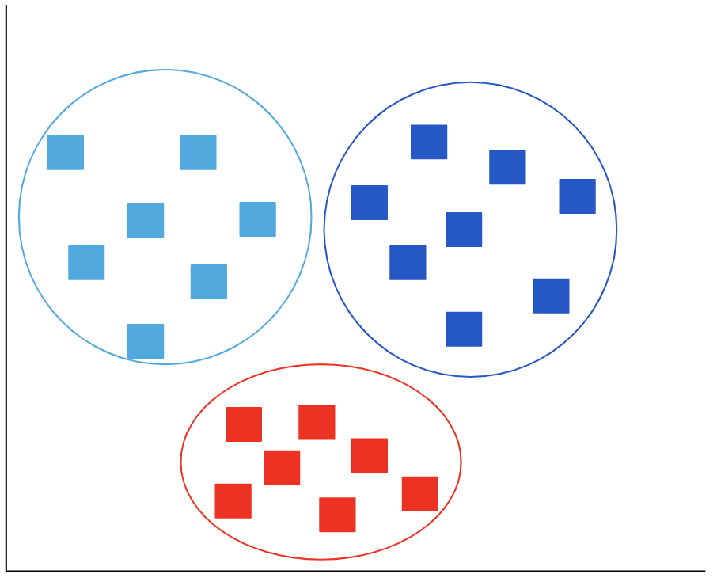
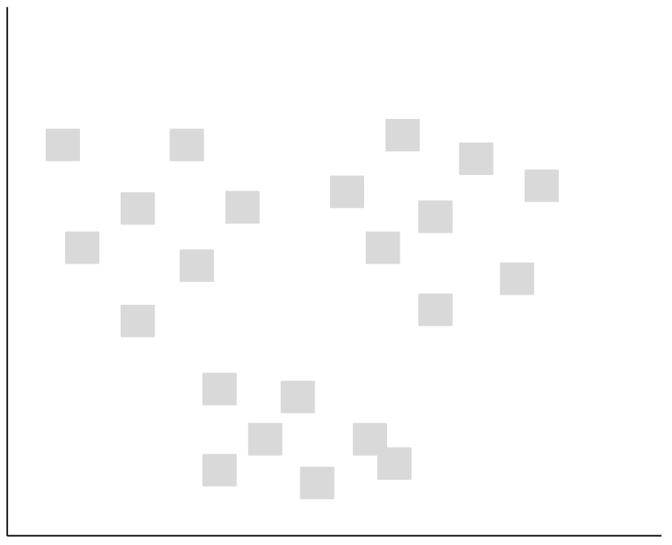
Clustering
Clustering is a technique in which data is grouped based on the similarities in them.
Raw data
Clustered data

Slide 7
Clustering
Clustering partitions the data into natural groups such that
Points in the cluster are as similar as possible
Points across the clusters are as dissimilar as possible

Slide 8
Types of clustering
Partition based: Observations are partitioned into predetermined number of clusters based on distance (K-means clustering)
Density based: Clusters are formed based on the density of observations (DBSCAN)
Hierarchical based: Hierarchy of clusters are formed based on the distances between the observations (Hierarchical clustering)
Graph based: Clusters are formed either by dividing a set of graphs or dividing the nodes of a graph (K-spanning tree)
Model based: Assumes that the data is a mixture of distributions and tries to fit a model such that each distribution represents a cluster (Gaussian Mixture Model)

Slide 9
Clustering approach
Clustering Approach
Hard Clustering
Soft Clustering
Each point is assigned to only one cluster
eg. K-means clustering
The probability of each cluster for each of the points is obtained
eg. Gaussian Mixture Model

Slide 10
Classification and clustering
In the classification problem, the target variable is known and is categorical
A model is trained on this information and new data is classified accordingly
In clustering, groups of data are formed based on similarity in observations

Slide 11
Visiting Basics

Slide 12
Proximity measures
The proximity measures find the distance between two instances
Proximity measures include
Similarity measures
Dissimilarity measures
Depending upon the data types, we choose the proximity measure

Slide 13
Similarity and dissimilarity measures
A similarity measure for two objects return the value between 0 and 1. For the completely similar objects the similarity measure is 1.
A dissimilarity measure for two objects return the value between 0 and 1. For the completely similar objects the dissimilarity measure is 0.
x₁ x₂ x_{n}
x₁ x₂ x_{n}
x₁
x₂
x_{n}
1
d₁₂ 1
⋱
d_{1n} d_{2n} … 1
x₁
x₂
x_{n}
0
d₁₂ 0
⋱
d_{1n} d_{2n} … 0

Slide 14
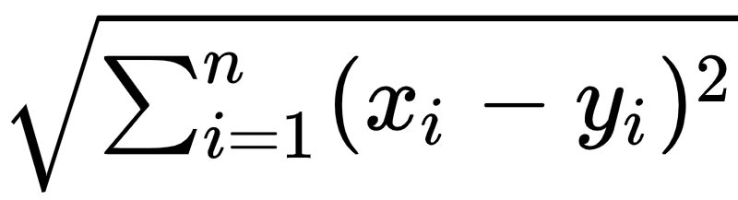
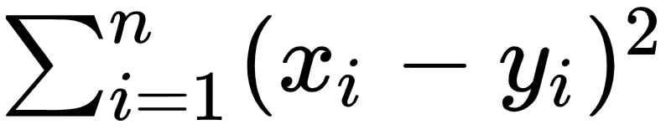
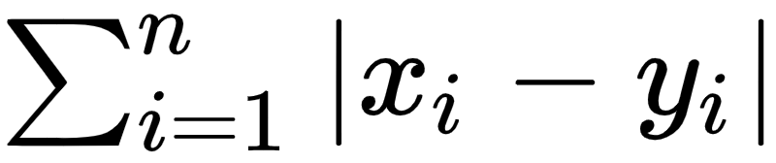
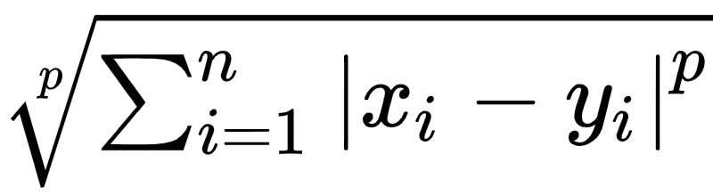
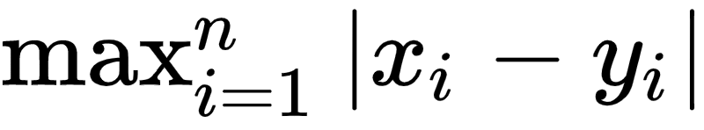
Distance measures for numeric data
The x_{i} and y_{i} are the values taken by variables X and Y respectively
Distance Measure | Formula
Euclidean measure
Squared Euclidean distance
Manhattan distance
Minkowski distance
Chebyshev’s distance

Slide 15
K - means Algorithm
Specifies the number of clusters
Specifies average (centroid) of a cluster

Slide 16
K-means algorithm
Used when data is numeric
Recursive technique
Can not train a model
Based on proximity measures
Greedy algorithm
Minimizes the squared error of points in its cluster
Non-deterministic algorithm

Slide 17
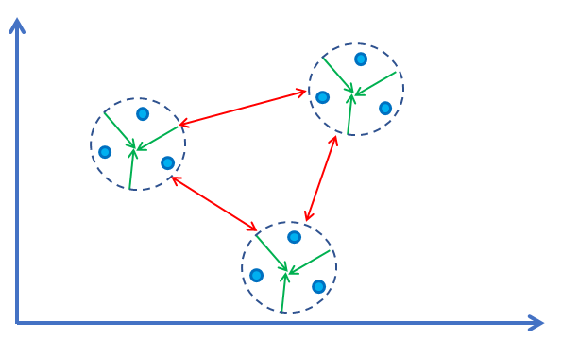
Objective of clustering
1. Reduce variation within cluster
2. Increase variation between clusters

Slide 18
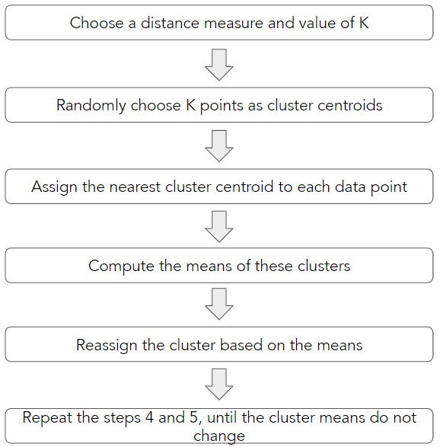
K-means algorithm - procedure

Slide 19
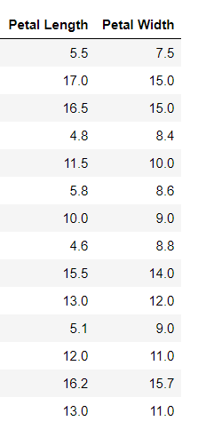
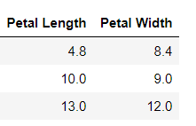
Example:
Create a dataframe of the given data.

Slide 20
Example: step 1
Let us first plot the data.
From the plot, we can see that the dataset is divided into 3 groups.
Now, use K-means clustering to check whether the algorithm can form such three clusters (K = 3) from the given data. Consider the Euclidean distance as a distance measure.

Slide 21
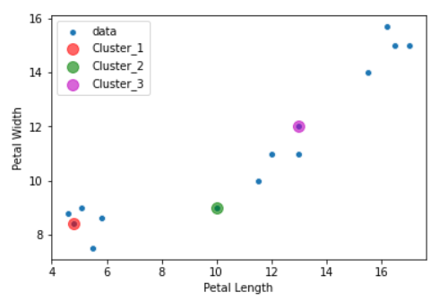
Example: step 2
Initial assignment:
Randomly choose 3 points as cluster centroids.
Consider the below observations as initial centroids.
mean

Slide 22
Initial centroid assignment methods
Two methods for initializing cluster centroids: Forgy, Random Partition
Forgy method assigns K random observations as cluster centroids for K clusters
In Random Partition method, a cluster is randomly assigned to each data point, and the mean of data in each cluster is considered as cluster centroid

Slide 23
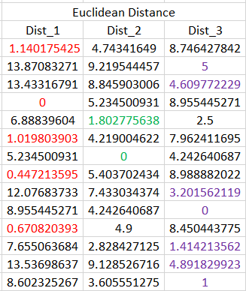
Example: step 3
Calculate the Euclidean distance of each point from cluster centroids.
The table shows that the 1st point is closest to the first cluster, the 2nd point is closest to the third cluster and so on.

Slide 24
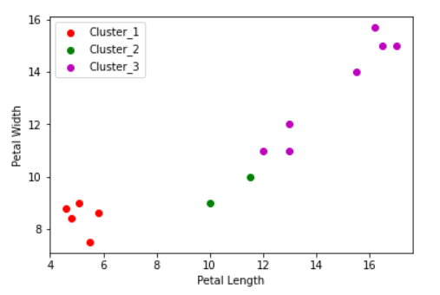
Example: step 3
Assign the data to the nearest cluster.
The plot shows that 1st cluster contains 5 points, the 2nd cluster contains 2 points, and the 3rd cluster contains 7 points.

Slide 25
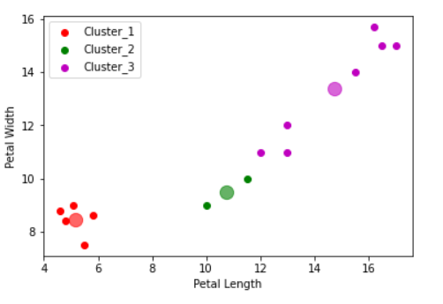
Example: step 4
1st iteration:
In step 3, we have obtained 3 clusters based on the initial centroid assignment. Now calculate the means of these clusters.
mean
Cluster | Mean Petal Length | Mean Petal Width
1 | 5.16 | 8.46
2 | 10.75 | 9.50
3 | 14.74 | 13.39

Slide 26
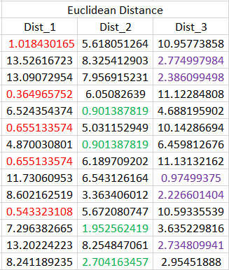
Example: step 5
Now again calculate the Euclidean distance of each point from the newly obtained cluster centroids.
We can see that some of the data points are closer to the new centroid. Also, two data points are shifted to the 2nd cluster from the 3rd cluster.

Slide 27
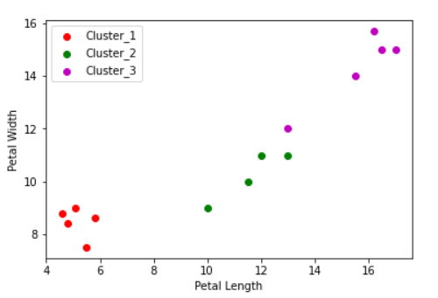
Example: step 5
Assign the data to the nearest cluster.
The plot shows that 1st cluster contains same 5 points as before, the 2nd cluster have 2 new points, and the 3rd cluster contains 5 points.

Slide 28
Example: step 6
Repeat steps 4 and 5, until the cluster centroids remains same.

Slide 29
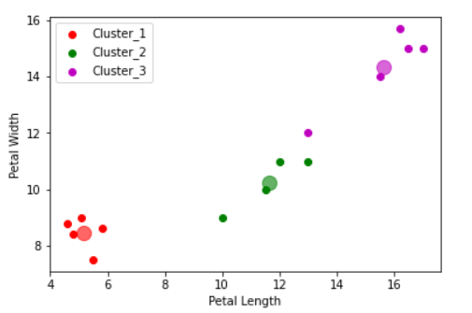
Example: repeat step 4
2nd iteration:
In step 5, we have obtained 3 clusters based on the centroids. Now calculate the means of the new clusters.
mean
Cluster | Mean Petal Length | Mean Petal Width
1 | 5.16 | 8.46
2 | 11.63 | 10.25
3 | 15.64 | 14.34
Note: The centroid for the cluster 1 is same as in the previous step.

Slide 30
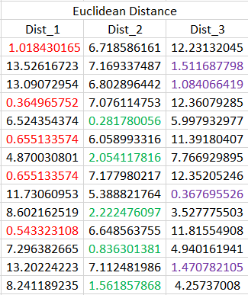
Example: repeat step 5
Now again calculate the Euclidean distance of each point from the newly obtained cluster centroids.
The table shows that a new point is shifted to the 2nd cluster from the 3rd cluster.

Slide 31
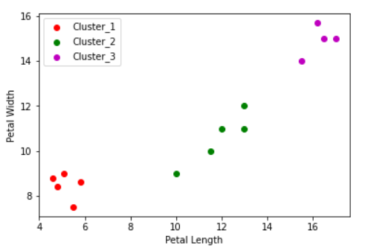
Example: repeat step 5
Assign the data to the nearest cluster.
Now the clusters are created as per our observation about the data.

Slide 32
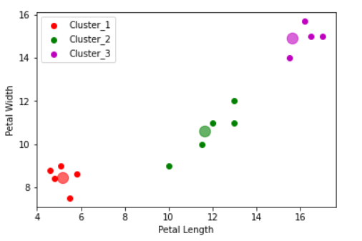
Example: repeat step 4
3rd iteration:
In previous step, we have obtained 3 clusters based on the centroids. Now calculate the means of the new clusters.
mean
Cluster | Mean Petal Length | Mean Petal Width
1 | 5.16 | 8.46
2 | 11.9 | 10.6
3 | 16.3 | 14.93
Note: The centroid for the cluster 1 is same as
in the previous step.

Slide 33
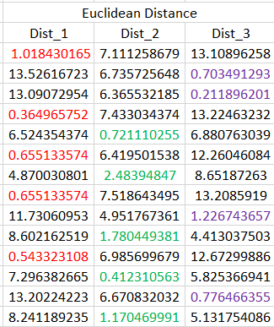
Example: repeat step 5
Now again calculate the Euclidean distance of each point from the newly obtained cluster centroids.
The table shows that the points belongs to the same cluster.

Slide 34
Example: repeat step 5
Assign the data to the nearest cluster.
There is no change in the points belonging to each cluster.

Slide 35
Example: repeat step 4
4th iteration:
In previous step, we have obtained 3 clusters based on the centroids. Now calculate the means of the new clusters.
mean
Cluster | Mean Petal Length | Mean Petal Width
1 | 5.16 | 8.46
2 | 11.9 | 10.6
3 | 16.3 | 14.93

Slide 36
Example: repeat step 4
4th iteration:
We can see that all the cluster centroids are the same as in the previous iteration. Thus we will stop the algorithm
The table shows the three clusters with the cluster centroids
Cluster | Mean Petal Length | Mean Petal Width
1 | 5.16 | 8.46
2 | 11.9 | 10.6
3 | 16.3 | 14.93

Slide 37
Inference
Cluster | Mean Petal Length | Mean Petal Width
1 | 5.16 | 8.46
2 | 11.9 | 10.6
3 | 16.3 | 14.93
The first cluster contains 5 flowers with the least average petal length and width. This represents the group of small-sized flowers
The second cluster represents 5 medium-sized flowers
The third cluster consists of 4 flowers with the highest average petal length and width
Thus, K-means has clustered the data into 3 clusters based on the length and width of each flower petal

Slide 38
Merits and demerits
Merits:
Easy to understand
Simple implementation
Demerits:
Finding the optimal value of K can be computationally expensive
Initial centroid assignment affects the final output
Not efficient in presence of outliers

Slide 39
Optimal value of K
In the previous example, it was obvious that the observations were divided into 3 groups; thus we considered K = 3
But in general, it is not easy to decide the optimal value of K
In this session, we study two common techniques to find the optimal value of K
One of the methods is using the Elbow Plot and the other one is the Silhouette Method

Slide 40

Elbow plot
K-means clustering aims to reduce the within-cluster variation
The elbow (or scree) plot is used to plot the within-cluster sum of squares (WCSS) for different values of K
Optimal K is the value corresponding to the elbow point
Where,
C_{j} is the j^{th} cluster and μ_{j} is the centroid of the j^{th} cluster

Slide 41
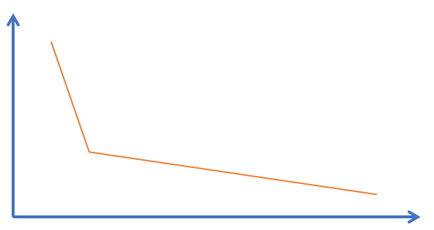
Elbow plot
WCSS
It is used to measure the variation within the cluster
Optimal K
No. of Clusters (K)

Slide 42
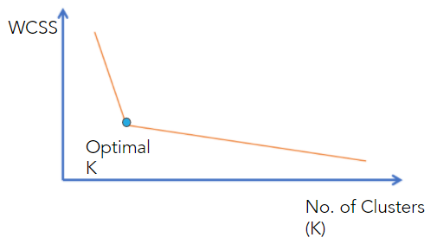
Elbow plot
The plot shows that the WCSS is decreasing rapidly for the K values less than the optimal K value
After the elbow point, the WCSS is steadily decreasing which implies that more clusters are formed by dividing the large clusters into subgroups
Selecting the K greater than optimal K leads to overfitting

Slide 43
Silhouette method
Silhouette score is used to find the optimal number of clusters
It is the mean silhouette coefficient over all the instances
The value of the silhouette score lies between -1 to +1
We plot the silhouette score for different values of ‘K’ and select the K with the highest score
It is a computationally expensive method
It is also used to validate the quality of clusters

Slide 44
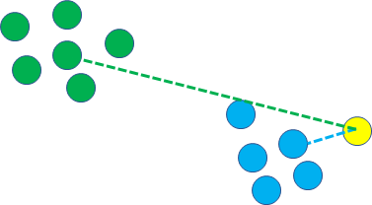
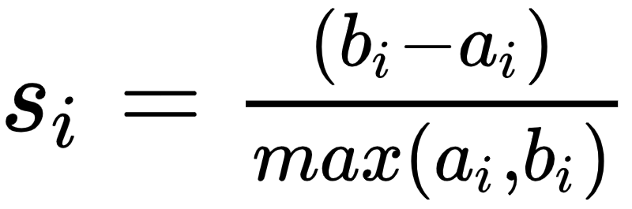
Silhouette coefficient
Silhouette coefficient of a single instance (observation) is given by:
a_{i} = mean distance between i^{th} point and other points in the same cluster (mean intra-cluster distance)
b_{i} = mean distance between i^{th} point and points of the next closest cluster (mean inter-cluster distance)
i^{th} instance
b_{i}
a_{i}

Slide 45
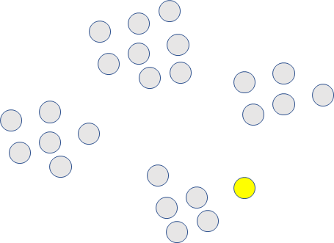
Step 1
For each point, we have to calculate the silhouette coefficient
Let’s consider the i^{th} point for which we will calculate the silhouette coefficient
i^{th} point

Slide 46
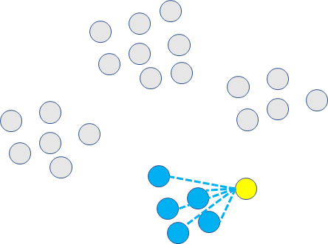
Step 2
Calculate mean intra-cluster distance (a_{i})
It is the average distance between i^{th} point and other points in the same cluster
Average = a_{i}

Slide 47
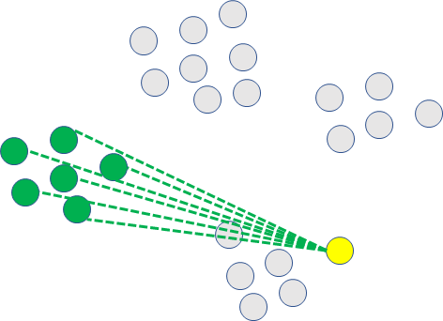
Step 3
For the same point, calculate mean inter-cluster distance(b_{i})
It is the average distance between i^{th} point and points of the next closest cluster
mean nearest-cluster = b_{i}

Slide 48
Step 4
Calculate s_{i} using the obtained values of a_{i} and b_{i}
Similarly calculate silhouette coefficient for each observation
The average silhouette coefficient of all the observations is the silhouette score

Slide 49
As per the objectives of cluster analysis, the variation within the cluster should be minimum and the variation between clusters should be maximum
Thus we want a_{i} to be much smaller than b_{i}, i.e. a_{i} << b_{i}
Ideally we want a_{i} = 0 and b_{i} = infinity

Slide 50
Silhouette method
There are several criteria to choose the optimal K using a silhouette plot
Select a value of K such that there are no outliers in each cluster
Select a value of K for which all the silhouette coefficients are greater than the average silhouette score
Select a value of K that has the highest average silhouette score

Slide 51
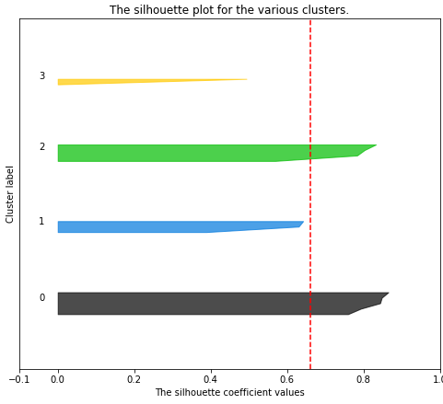
Silhouette coefficient less than average score
Generally the silhouette score of each cluster should be greater than the average score
In this figure, the average score is shown by a red dotted vertical line (----)
The silhouette coefficient for the 1st and 3rd cluster is less than the average score; thus K = 4 is not a good choice of K

Slide 52
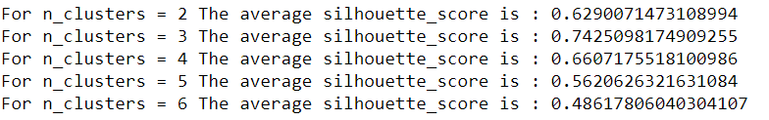
Maximum silhouette score
The value of K associated with the highest average silhouette score can be considered as an optimal value.

Slide 53
Summary
Elbow method and Silhouette score are two of the methods used to find the optimal value of K
Elbow method uses intra-cluster distance to determine the value of K
Silhouette score uses intra-cluster and inter-cluster distance
Silhouette plot can be used to detect the outliers

